Slide 1
Vector Time
Data Structures Week 1
Time is represented by n-dimensional non-negative integer vectors.
Each process p_{i} maintains a vector vt_{i} [1..n], where vt_{i}[i] is the local logical clock of p_{i} and describes the logical time progress at process p_{i}.
Vt_{i}[j] represents process p_{i} ’s latest knowledge of process p_{j} local time.
If vt_{i} [j]=x, then process p_{i} knows that local time at process p_{j} has progressed till x.
The entire vector vt_{i} constitutes p_{i} ’s view of the global logical time and is used to timestamp events.
The timestamp of an event is the value of the vector clock of its process when the event is executed.

Slide 2
Vector Time – Update Rules
Data Structures Week 1
Rules for Process p_{i} to update its clock:
Rule 1: Before executing an event, process p_{i} updates its local logical time as follows:
vt_{i} [i] := vt_{i}[i] + d where (d > 0)
Rule2: Each message m is piggybacked with the vector clock vt of the sender process at sending time. On the receipt of such a message (m,vt), process p_{i} executes the following sequence of actions:
    Update its global logical time as follows:
    1 ≤ k ≤ n : vt_{i}[k] := max(vt_{i}[k], vt[k])
    Execute Rule1.
    Deliver the message m.

Slide 3
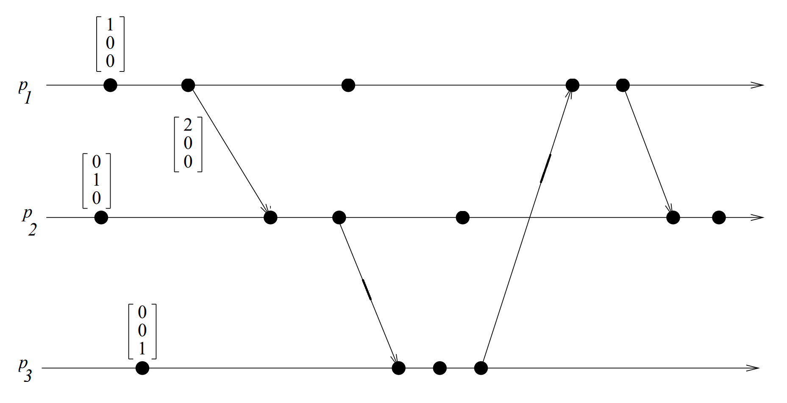
Vector Time – Example
Data Structures Week 1
P2’s second event:
max([2,0,0], [0,1,0])=[2,1,0]
Then Rule1: [2,2,0]

Slide 4
Data Structures Week 1
For process i, for d=1, are the events internal to the process ordered as a sequence1,2,3,4,.... Or could there be jumps ?

Slide 5
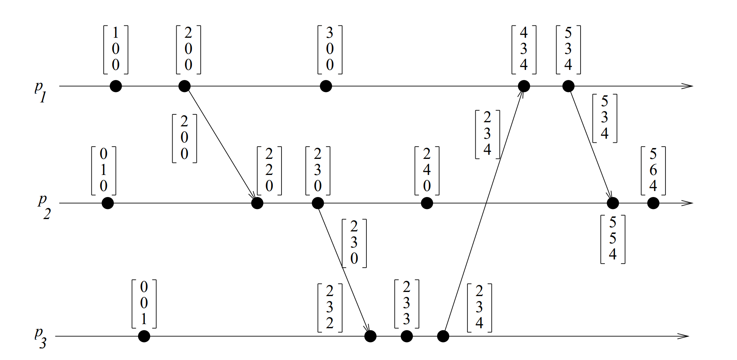
Vector Time – Example
Data Structures Week 1
Initially, a vector clock is [0, 0, 0, ...., 0]. d = 1.
Fill the timestamps for the other events.

Slide 6
Vector Time – Example
Data Structures Week 1
Using vector clocks, two timestamps vh and vk are compared as follows.
vh == vk iff for all indices i, vh[i] == vk[i]
vh <= vk iff for all indices i, vh[i] ≤ vk[i]
vh < vk iff vh ≤ vk and there exists an index i where vh[i] < vk[i].
vh || vk iff not(vh < vk) and not(vk < vh)

Slide 7
Properties of Vector Time
Data Structures Week 1
Event Counting: Use d = 1 always.
Then the i th component of vector clock at process p_{i},vt_{i}[i], denotes the number of events that have occurred at p_{i} until that instant.
So, if an event e has timestamp vh, vh[j] denotes the number of events executed by process p_{j} that causally precede e.
How many events causally precede e in the distributed computation ?

Slide 8
Properties of Vector Time
Data Structures Week 1
Event Counting: Use d = 1 always.
Then the i th component of vector clock at process p_{i},vt_{i}[i], denotes the number of events that have occurred at p_{i} until that instant.
So, if an event e has timestamp vh, vh[j] denotes the number of events executed by process p_{j} that causally precede e. Clearly, (Σ_{j} vh[j] ) − 1 represents the total number of events that causally precede e in the distributed computation.

Slide 9
Properties of Vector Time
Data Structures Week 1
Are Vector clocks strongly consistent ?

Slide 10
Strong consistency proof
Data Structures Week 1
Suppose not then ei->ej not double implies vi< vj
1- Show ei->ej implies vi< vj
2- Show vi< vj implies ei->ej
1. Suppose not then vi not < vi: However ei->ej either in same process or a send msg or because of ez such that ei->ez->ej
a) If same process then both are vectors of the same process and Vki[k]<Vkj[k]
b) Let two vectors be Vim and Vjn. if send msg then Vim[i]=Vjn[i] and Vim[j]< Vjn[j] and for all other k, Vim[k]>=Vjn[k]
c) By a and b we have vi<vj
2)Suppose not then vi<vj but ei not -> ej
For two events of the same process vectors can only increase.
For two events of different process assume vi<vj but ei not -> ej. That is
vi<vj but ej -> ei or ei|| ej.
If ej -> ei: Consider Vim[i] and Vjn[i]. Since ej -> ei we have Vjn[i] <Vim[i] so vi not <vj. Contradiction.
If ei || ej: Consider congruent vectors V1 and V2 on processes A and B respectively. V1[A] would have been the timestamp of A when event ei of V1 happened and similarly V2[B] is timestamp of B when ej of V2 happened. Now as they are congruent; the information of V1[A] would not reach B and V2[B] would not reach A. Hence V1[A] > V2[A] and V1[B] < V2[B]. Contradiction.

Slide 11
Properties of Vector Time
Data Structures Week 1
Strong Consistency: Vector clocks are strongly consistent.
What are the limitations of the vector clock?

Slide 12
Limitations of Vector Time
Data Structures Week 1
Large message sizes owing to the vector being piggybacked on each message.
The message overhead grows linearly with the number of processors in the system and when there are thousands of processors in the system, the message size becomes huge even if there are only a few events occurring in few processors.
Few techniques exist to reduce the overhead.
What can we do to reduce the load?

Slide 13
Vector Time – Example
Data Structures Week 1
Initially, a vector clock is [0, 0, 0, ...., 0]. d = 1.
Fill the timestamps for the other events.

Slide 14
Optimizations
Data Structures Week 1
Consider a message from P_{i} to P_{j}.
The message includes the vector time at P_{i}.
Of the n components of the vector time, only few would have changed since the last time P_{i} sent a message to P_{j}.
Need to include only those tuples.
  (i₁, t₁), (i₂, t₂), ...
Update rule changes slightly so that:
  P_{j} updates the component k of its vector time to max{vt_{j}[k], tk} where tk is the time reported by P_{i} with the tuple (k, tk)
Are we missing something?

Slide 15
Optimizations
Data Structures Week 1
Message sizes decrease in general, but local storage may increase.
  Need to know the vector time at P_{i} when the last message was sent to P_{j}, for each j.
  That is, each process stores the last msg sent to every other process.
  O(n²) storage per process.
A clever optimization can bring this storage to O(n) – Singhal kshemkalyanis technique

Slide 16
Singhal- Kshemkalyani Differential Technique
Data Structures Week 1
Process pi maintains the following two additional vectors:
◮LS_{i}[1..n] (‘Last Sent’) : Ls_{i}[j] indicates the value of vt_{i}[i] when process p_{i} last sent a message to process p_{j}.
◮LU_{i}[1..n] (‘Last Update’):LU_{i}[j] indicates the value of vt_{i}[i] when process p_{i} last updated the entry vt_{i}[j].
LU_{i}[i] =vt_{i}[i] ?
When do you update LS and LU ?
Can we put LS and LU together to know what is the information that needs to be piggybacked on the message ?

Slide 17
Singhal- Kshemkalyani Differential Technique
Data Structures Week 1
Process pi maintains the following two additional vectors:
◮LS_{i}[1..n] (‘Last Sent’) : Ls_{i}[j] indicates the value of vt_{i}[i] when process p_{i} last sent a message to process p_{j}.
◮LU_{i}[1..n] (‘Last Update’):LU_{i}[j] indicates the value of vt_{i}[i] when process p_{i} last updated the entry vt_{i}[j].
Clearly,LU_{i}[i] =vt_{i}[i] at all times
Lu_{i}[j] needs to be updated only when the receipt of a message causes p_{i} to update entry vt_{i}[j].
LS_{i}[j] needs to be updated only when p_{i} sends a message to p_{j}

Slide 18
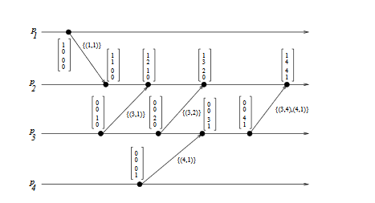
Data Structures Week 1

Slide 19
Singhal- Kshemkalyani Differential Technique
Data Structures Week 1
Since the last communication from pi to pj , only those elements of vector clock vt_{i}[k] have changed for which LS_{i}[j] < Lu_{i}[k] holds. Hence, only these elements need to be sent in a message from p_{i} to p_{j}.
When p_{i} sends a message to p_{j} , it sends only a set of tuples { (x,vt_{i}[x]) | LS_{i}[j] < LU_{i}[x] } as the vector timestamp to p_{j}, instead of sending a vector of n entries in a message.
Home Work !!
Think about whether vector clocks can detect out of order msgs.
Will Singhal-Kshemkalyanis technique work if the messages
are not in FIFO order ?

Slide 20
Teasers-1
Data Structures Week 1
Suppose I want to know whether an updation event at site D at time t which was propagated(broadcasted) to all sites has reached everyone.
Nodes need this information to determine when it is safe to discard/stabilize updates.
Can I decipher looking at B’s vector sent to me if B has received the msg from D?

Slide 21
Teasers-1
Data Structures Week 1
Suppose B received a msg from C before it sent a msg to me then
B updates as
V_{B}[D]= max(V_{B}[D], V_{C}[D]).
Hence we do not know if V_{B}[D] is update from C or an update B already had from D.

Slide 22
Teasers-2
Data Structures Week 1
Suppose I want to know whether an updation event at site D at time t which was propagated to all sites has reached everyone assuming causual order and no lost messages:
Consider the below:
B sends msg to me. Can I know if B received the msg from D?

Slide 23
Teasers-2
Data Structures Week 1
Let us assume that B got D’s news through C.
Now, that means there were two msgs with recipient as B. One Is the msg from D and another is a msg from C due to which VB[D]=VC[D].
Now by causual order if two msgs are intended for the same destination; then the one sent first should reach first.
Can the msg from C to B with D’s update be sent before D’s msg to B?
No as D had broadcast all its msgs. So C can be sending the update on D to B only after D sent a msg to B.
Hence D’s msg to B will reach first and the update could not have come through anyone else

Slide 24
Teasers-3
Data Structures Week 1
Once again consider causal order:
I want to know of D’s msg has reached everyone.
Instead of receiving a msg from everyone if I receive a msg from B such that V_{B}[x] >= t for all x then can I conclude that all have received the broadcast from D?

Slide 25
Teasers-3
Data Structures Week 1
Instead of receiving a msg from everyone if I receive a msg from B such that V_{B}[x] >= t for all x then can I conclude that all have received the broadcast from D?
No.
P might have progressed to t. Then sent a msg to B. Then received a msg from D. So V_{B}[P] >= t does not necessarily imply that P has heard from D.
Note: If P had received a msg from D and P sends a msg to B then by causal order B receives msg from D before msg from P.
However, If P has not received a msg from D and P sends a msg to P then it is not necessary that B receives msg from D before msg from P.

